Slide 1







Mini-Project III Group 1
Department of Computer Science and Engineering

Slide 2





Our Team
Course Co-Ordinator : Narule Mam
Anusha
Patil
B44
Shrutika
Patil
B50
Adarsh
Gurav
B73
Sanket
Magdum
B77

Slide 3




Introduction
Today, we will present three real-world problems that people face in their daily lives.
We have designed smart solutions using Machine Learning (ML), hardware, and software.
These solutions help to make work easier, faster, and more accurate.
Our goal is to show how technology can solve real-life problems and improve people's lives.

Slide 4



: Project Title :
01
02
03
Ai based traffic management
System
Smart waste segregation and recycling system

Slide 5

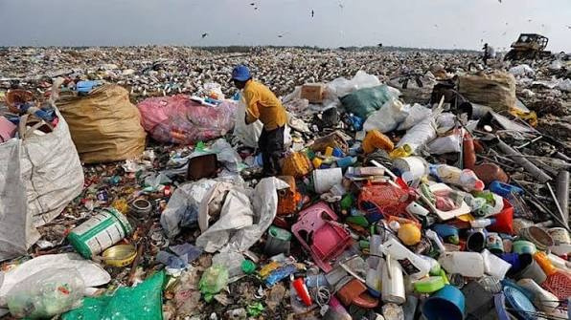


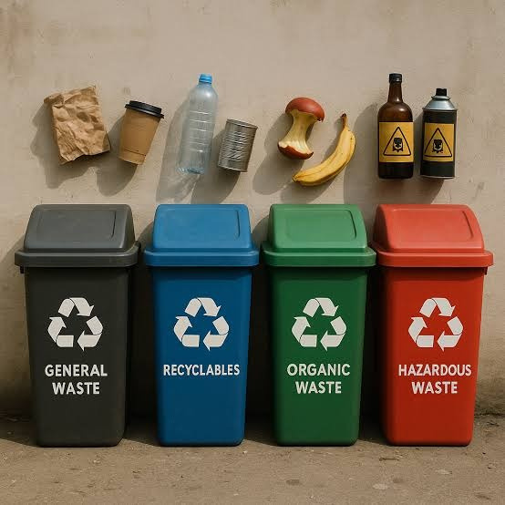
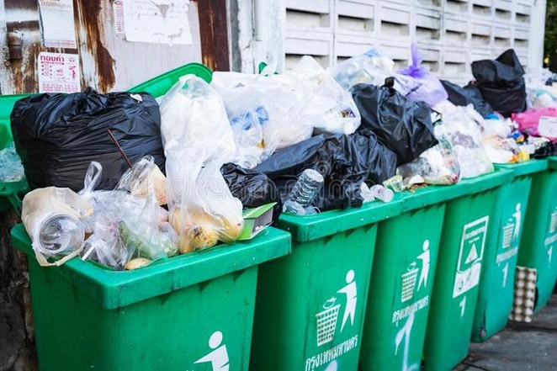

Slide 6



01
Smart waste segregation and recycling system
SIH PS Gov of Odisha

Slide 7



Problem in real world
Garbage bins overflow due to improper monitoring and collection.
Mixed waste makes recycling difficult and increases landfill waste.
Plastic and other waste pollute roads, rivers, and the environment.
How We Are Going to Resolve It
Use AI to automatically identify and segregate different types of waste.
Monitor bin fill levels using IoT sensors and send alerts when full.
Store waste data on a dashboard for better waste management.
Target users : shopping malls , schools , airport , public place , home
Reward System

Slide 8
Basic Idea And Existing Product
A camera captures the waste image when it is thrown into the bin.
AI classifies the waste and a motor opens the correct compartment.
Sensors monitor the bin level and send data to the cloud/dashboard.
Technology Used
Hardware: ESP32/Raspberry Pi, Camera, Ultrasonic Sensor, Servo Motor.
Software: Python, OpenCV, YOLO.
Dashboard: HTML, CSS, JavaScript.
components-3D printer and software used for it

Slide 9

02
Smart Traffic Management Systern for Urban Congestion
SIH25050 - Software edition - Government of odisha

Slide 10
How We Are Going to Resolve It
Problem in real world
Capture and detect live traffic using CCTV/SUMO with YOLO + OpenCV.
Analyze traffic density and queue length in real time.
Optimize traffic signals dynamically using an AI decision engine.
Prioritize emergency vehicles and provide live monitoring through a React dashboard.
Increasing vehicle population leads to severe urban traffic congestion.
Fixed-time traffic signals cannot adapt to real-time traffic conditions.
Long waiting times result in fuel wastage and higher CO₂ emissions.
Emergency vehicles are delayed due to inefficient traffic management.

Slide 11
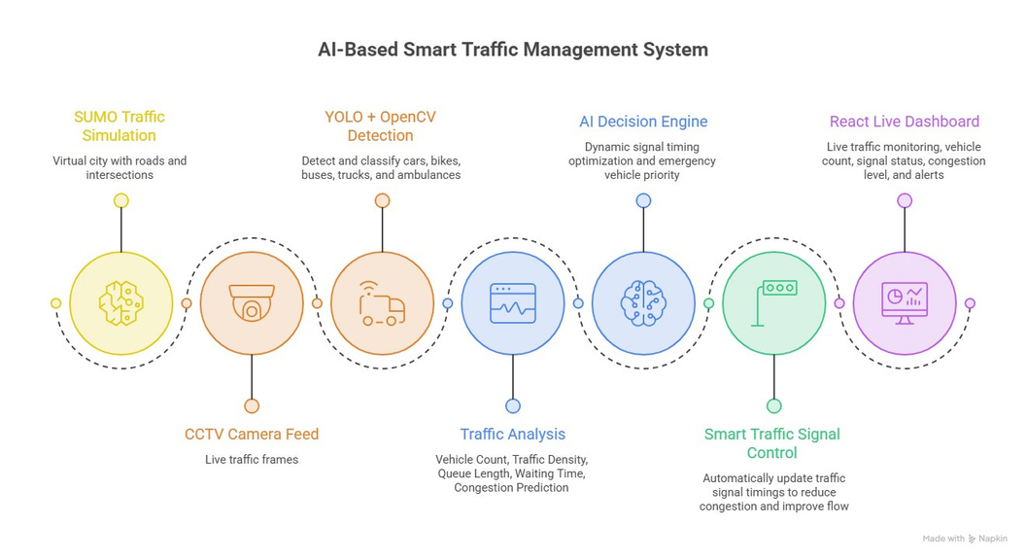
Basic Idea And Existing Product
Technology Used
Frontend : React.js
Backend & AI : Python, YOLO, OpenCV, FastAPI/Flask
Simulation SUMO (Simulation of Urban Mobility)

Slide 12
-: Conclusion :-
These three problem statements focus on solving important real-world problems using AI, Machine Learning, hardware, and software.
The proposed systems help to reduce waste, keep water bodies clean, and improve traffic management.
These solutions can save time, resources, and human effort while making our environment cleaner, safer, and smarter.
With further development and real-world implementation, these ideas can contribute to building smart and sustainable cities.

Slide 13
Contents of this temlate
You can delete this slide when you’re done editing the presentation
Fonts | To view this template correctly in PowerPoint, download and install the fonts we used
Used and alternative resources | An assortment of graphic resources that are suitable for use in this presentation
Thanks slide | You must keep it so that proper credits for our design are given
Colors | All the colors used in this presentation
Icons and infographic resources | These can be used in the template, and their size and color can be edited
Editable presentation theme | You can edit the master slides easily. For more info, click here
For more info:
SLIDESGO | BLOG | FAQs
You can visit our sister projects:
FREEPIK | FLATICON | STORYSET | WEPIK | VIDEVO

Slide 14




Here are three important ideas
Jupiter
Venus
Saturn
Jupiter is a gas giant and the biggest planet in the Solar System. It's the fourth-brightest object in the night sky and was named after the Roman god of the skies and lightning
Venus has a beautiful name and is the second planet from the Sun. It’s the second-brightest object in the night sky after the Moon. Its temperatures are extremely high
Saturn is a gas giant and has several rings. This planet is composed mostly of hydrogen and also helium. Saturn was named after the Roman god of wealth and agriculture

Slide 15




Divide the content in four ideas
Mars
Venus
Despite being red, Mars is actually a cold place. It's full of iron oxide dust, which gives the planet its reddish cast, and it’s made of basalt
Venus has a beautiful name and is the second planet from the Sun. It’s terribly hot and its atmosphere is extremely poisonous
Jupiter
Saturn
Jupiter is a gas giant and the biggest planet in the Solar System. It's the fourth-brightest object in the night sky and was named after a Roman god
Saturn is a gas giant and has
several rings. This planet is composed mostly of hydrogen and helium. It’s the sixth planet from the Sun

Slide 16

“This is a quote, words full
of wisdom that someone important said and can make the reader
get inspired.”
—Someone Famous

Slide 17


A picture is worth a thousand words

Slide 18


98,300,000
Big numbers catch your audience’s attention

Slide 19



9h 55m 23s
Jupiter’s rotation period
333,000
The Sun’s mass compared to Earth’s
386,000 km
Distance between Earth and the Moon

Slide 20

Let’s use some percentages
25%
50%
75%
Mercury
Venus
Mars
Mercury is the closest planet to the Sun and the smallest of them all
Venus has a beautiful name and is the second planet from the Sun
Despite being red, Mars is a cold place. It’s full of iron oxide dust

Slide 21


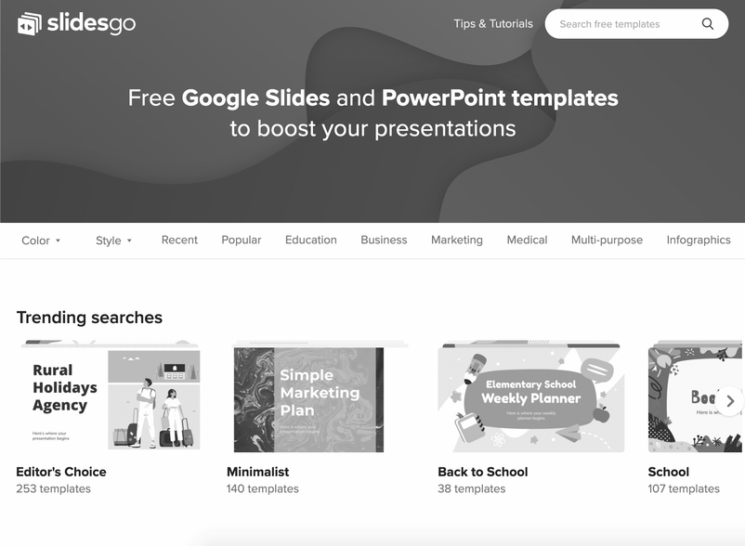

Computer mockup
You can replace the image on the screen with your own work. Just right-click on it and select “Replace image”

Slide 22

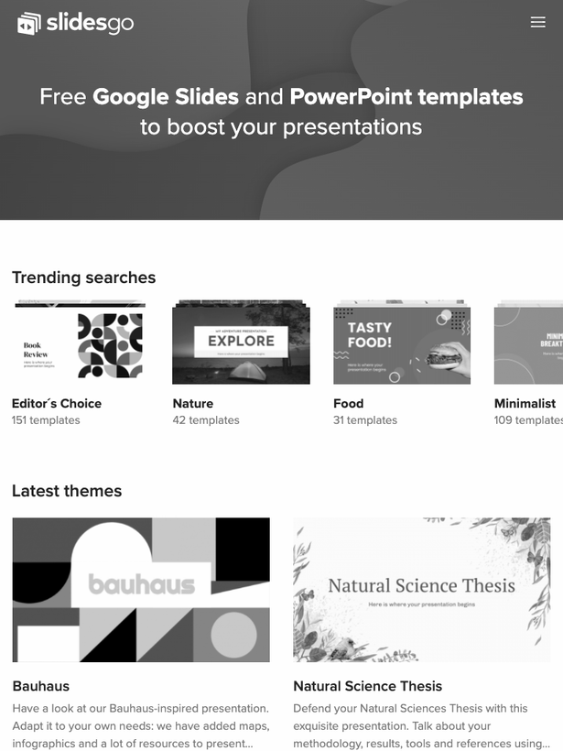

Tablet mockup
You can replace the image on the screen with your own work. Just right-click on it and select “Replace image”

Slide 23


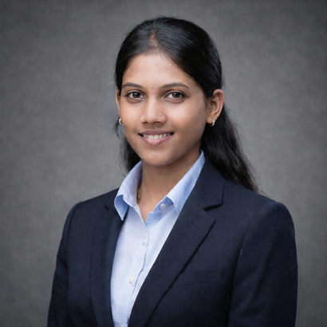
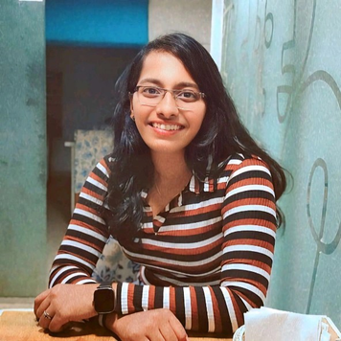



Our team
Anusha Patil
B44
Shrutika Patil
B50
Adarsh Gurav
B73
Sanket Magdum
B77

Slide 24

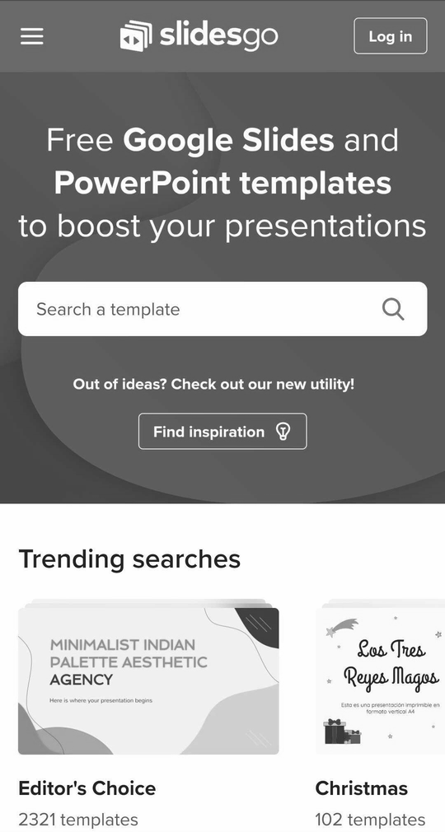
Phone mockup
You can replace the image on the screen with your own work. Just right-click on it and select “Replace image”

Slide 25

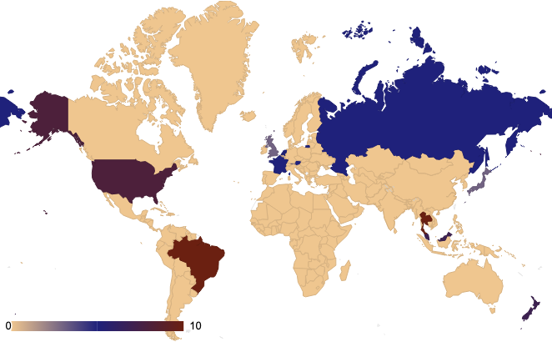
This is a map
Mars
Mars is very cold
Mercury
Mercury is small
Venus
Venus is very hot
Follow the link in the map to modify its data and then paste the new one here. For more info, click here

Slide 26
Business program
Attractive business model
Growth and
expansion strategy
Reorientation or abandonment strategy
High competitive strength
Low competitive strength
Maintenance and protection strategy
Reduction or elimination strategy
Unattractive business model

Slide 27

Marketing analysis
Market overview | Market overview
Market size
Market growth
Market segmentation | Segment 1:
Market segmentation | Segment 2:
Market trends | Trend 1:
Market trends | Trend 2:
Target | Target
Demographics | Age:
Demographics | Gender:
Demographics | Income:
Psychographics | Attitude:
Psychographics | Values:
Behaviors | Purchasing habits:
Behaviors | Frequency of purchases:

Slide 28

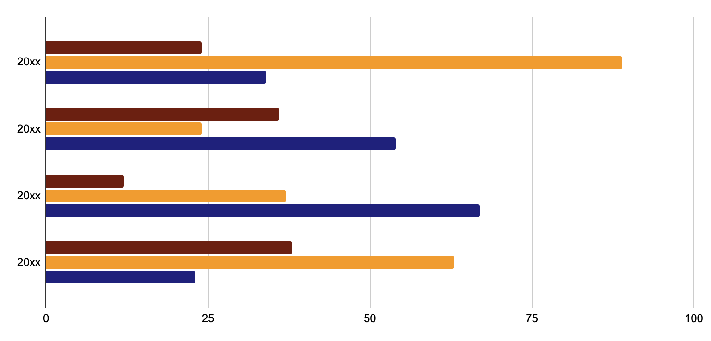
You can use this graph
Team 1
Team 2
Team 3
Follow the link in the graph to modify its data and then paste the new one here. For more info, click here

Slide 29
Quarterly goals
Main goals of the quarter | Main goals of the quarter | To be achieved by
1
2
3
4
5
6
7
8
Action plan of each month | Action plan of each month | Action plan of each month | Action plan of each month
1 |  | ⃞
1 |  | ⃞
1 |  | ⃞
2 |  | ⃞
2 |  | ⃞
2 |  | ⃞
3 |  | ⃞
3 |  | ⃞
3 |  | ⃞

Slide 30
A timeline always works well
Step 1
Step 2
Step 3
Step 4
Venus is a hot planet
Mercury is very small
Mars is a cold place
Jupiter is gas giant
Step 5
Step 6
Step 7
Step 8
Saturn has rings
The Sun is a star
Earth harbors life
Neptune is ice giant

Slide 31









Infographics are useful
Mars
Venus
Jupiter
Saturn
Earth
Moon

Slide 32


















































Icon pack

Slide 33






Alternative resources
Here’s an assortment of alternative resources whose style fits that of this template:
Vectors
Hand drawn notebook label collection
Free vector notebook with pen and ruler

Slide 34
Resources
Did you like the resources on this template? Get them for free at our other websites:
Vectors
Flat design spiral book mockup
Spiral book mockup design
Traditional songket seamless pattern template
Hand drawn notebook label collection
Photos
Medium shot smiley woman at work
Medium shot people having work meeting
Elegant and cozy office lifestyle
Young japanese woman portrait
Smiley young girl with brown hair
Icon
Startups icon pack lineal

Slide 35
Instructions for use
If you have a free account, in order to use this template, you must credit Slidesgo by keeping the Thanks slide. Please refer to the next slide to read the instructions for premium users.
As a Free user, you are allowed to:
Modify this template.
Use it for both personal and commercial projects.
You are not allowed to:
Sublicense, sell or rent any of Slidesgo Content (or a modified version of Slidesgo Content).
Distribute Slidesgo Content unless it has been expressly authorized by Slidesgo.
Include Slidesgo Content in an online or offline database or file.
Offer Slidesgo templates (or modified versions of Slidesgo templates) for download.
Acquire the copyright of Slidesgo Content.
For more information about editing slides, please read our FAQs or visit our blog:
https://slidesgo.com/faqs and https://slidesgo.com/slidesgo-school

Slide 36
Instructions for use (premium users)
As a Premium user, you can use this template without attributing Slidesgo or keeping the Thanks slide.
You are allowed to:
Modify this template.
Use it for both personal and commercial purposes.
Hide or delete the “Thanks” slide and the mention to Slidesgo in the credits.
Share this template in an editable format with people who are not part of your team.
You are not allowed to:
Sublicense, sell or rent this Slidesgo Template (or a modified version of this Slidesgo Template).
Distribute this Slidesgo Template (or a modified version of this Slidesgo Template) or include it in a database or in any other product or service that offers downloadable images, icons or presentations that may be subject to distribution or resale.
Use any of the elements that are part of this Slidesgo Template in an isolated and separated way from this Template.
Register any of the elements that are part of this template as a trademark or logo, or register it as a work in an intellectual property registry or similar.
For more information about editing slides, please read our FAQs or visit our blog:
https://slidesgo.com/faqs and https://slidesgo.com/slidesgo-school

Slide 37
Fonts & colors used
This presentation has been made using the following fonts:
Balsamiq Sans
(https://fonts.google.com/specimen/Balsamiq+Sans)
Inconsolata
(https://fonts.google.com/specimen/Inconsolata)
#2e2f38
#6b2011
#933d28
#f09c31
#efc68f
#f0f0c2
#1f217b

Slide 38

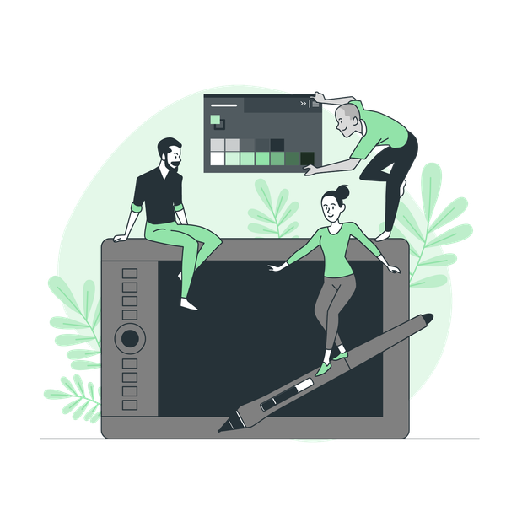



Storyset
Create your Story with our illustrated concepts. Choose the style you like the most, edit its colors, pick the background and layers you want to show and bring them to life with the animator panel! It will boost your presentation. Check out how it works.
Pana
Amico
Bro
Rafiki
Cuate

Slide 39

























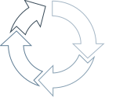








Use our editable graphic resources...
You can easily resize these resources without losing quality. To change the color, just ungroup the resource and click on the object you want to change. Then, click on the paint bucket and select the color you want. Group the resource again when you’re done. You can also look for more infographics on Slidesgo.

Slide 40
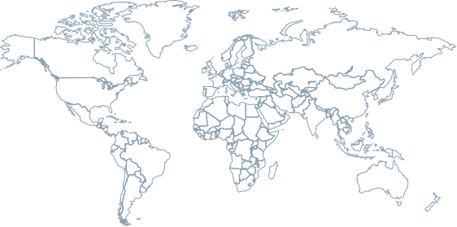

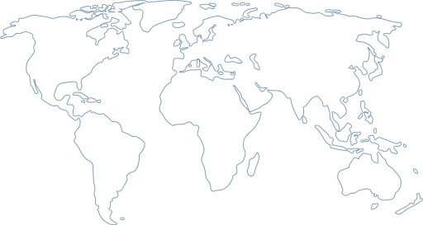


















Slide 41
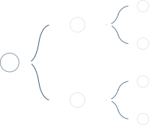



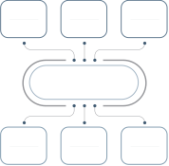




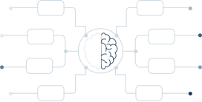
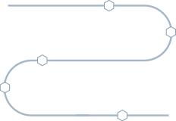



Slide 42
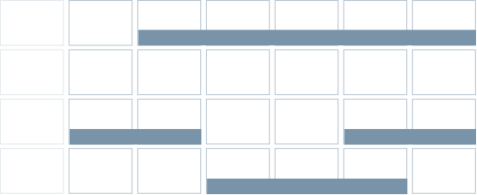

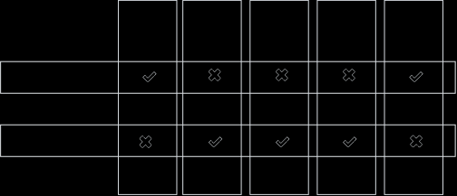
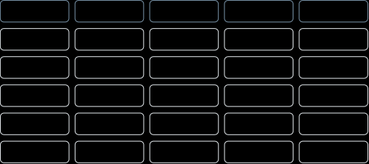
JANUARY
FEBRUARY
MARCH
APRIL
MAY
JUNE
PHASE 1
Task 1
Task 2
PHASE 2
Task 1
Task 2
JANUARY
FEBRUARY
MARCH
APRIL
PHASE 1
Task 1
Task 2

Slide 43

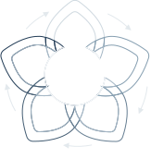


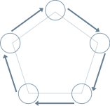












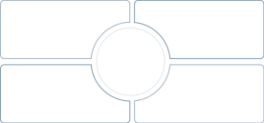
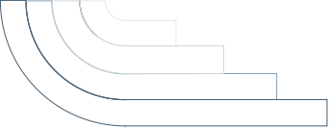














Slide 44



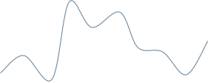






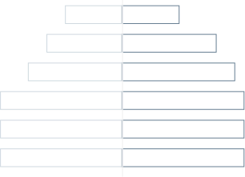
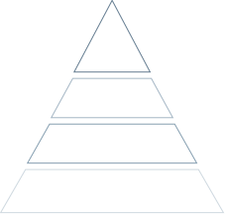




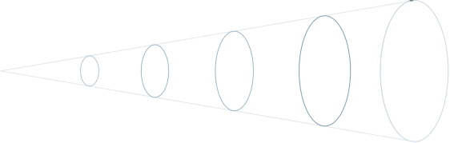



Slide 45


























































































...and our sets of editable icons
You can resize these icons without losing quality.
You can change the stroke and fill color; just select the icon and click on the paint bucket/pen.
In Google Slides, you can also use Flaticon’s extension, allowing you to customize and add even more icons.

Slide 46




































































































Educational Icons
Medical Icons

Slide 47




































































































Business Icons
Teamwork Icons

Slide 48




































































































Help & Support Icons
Avatar Icons

Slide 49


























































































Creative Process Icons
Performing Arts Icons

Slide 50


















































Nature Icons

Slide 51


































































SEO & Marketing Icons

Slide 52


